Slide 1

Immigration and Population Replacement Rates
The Handmaid’s Tale Effect

Slide 2

The Republic of Gilead is a futuristic place where most women of childbearing age have lost their fertility.
So women who are still fertile – and who can’t manage to escape - are forced to bear children for the powerful and elite.
These women are called Handmaids.
Could this happen for real?
What about in the United States?

Slide 3
key terms
Population projection components:
Live birth rate – native and non-native (immigrant) women
Death rate
Net International Migration (NIM)
Total Fertility Rate (TFR)
Formula: (# live births / # women ages 15 – 44) * 1000
Replacement Rate: TFR = 2.1 (population stays stable)
If TFR < 2.1, lower death rate and/or higher NIM can offset
This study assumes constant death rate

Slide 4
Current United States fertility facts
W
x
y
z

Slide 5
Current global fertility facts
W
x
y
z

Slide 6
TFR and gross domestic product (GDP)
W
x
y
z

Slide 7
united states NIM
W
x
y
z

Slide 8
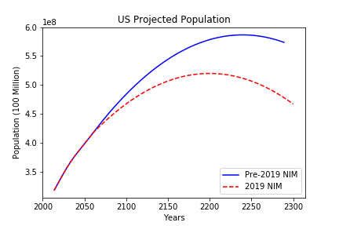
united states population trends
Blue line shows projection based on current TFR and pre-2019 NIM rate.
Red line shows projection based on current TFT and 2019 NIM rate.
Key finding: growth flattens 70 years earlier with lower NIM rate

Slide 9
KEY References
US Census 2017 National Population Projections Datasets https://www.census.gov/data/datasets/2017/demo/popproj/2017-popproj.html
World Bank (TFR, GDP) https://www.worldbank.org/
US fertility rate is below level needed to replace population https://www.cnn.com/2019/01/10/health/us-fertility-rate-replacement-cdc-study/index.html
Births: Provisional Data for 2018 https://www.cdc.gov/nchs/data/vsrr/vsrr-007-508.pdf

